Slide 1


Model View Controller (MVC)
Software Design Strategy
User Interface
Software
User Events
Pixels
View
Refresh
Controller
Data
Model
Changes

Slide 2




Model (Data)
Line object
$$y_{max}$$
Point object
$$x_{min}$$
$$x_{max}$$
$$y_{min}$$

Slide 3

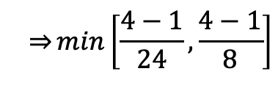
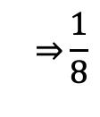
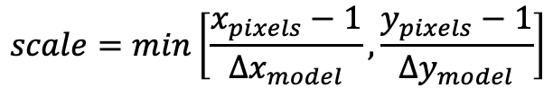
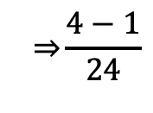



View
4 (points)
3 (distance)
$$x_{max}−x_{min}=24$$
0,0 | 1,0 | 2,0 | 3,0
0,1 | 1,1 | 2,1 | 3,1
0,2 | 1,2 | 2,2 | 3,2
0,3 | 1,3 | 2,3 | 3,3
(-12, 4)
4
(points)
3
(distance)
$$y_{max}−y_{min}=8$$
(12, -4)
$$model$$
$$pixels$$
$$scale=min\left[\frac{x_{pixels}−1}{∆x_{model}}, \frac{y_{pixels}−1}{∆y_{model}}\right]$$
$$\overset{⇒}{}min\left[\frac{4−1}{24}, \frac{4−1}{8}\right]$$
$$\overset{⇒}{}\frac{4−1}{24}$$
$$\overset{⇒}{}\frac{1}{8}$$

Slide 4














View
$$x_{min}=−12$$
$$+y$$
$$+y$$
(24, 8)
$$+y$$
Translate
Negate
(-12, 4)
(0,0)
$$y_{max}=4$$
(0,0)
$$-x$$
$$+x$$
(12, -4)
$$+x$$
$$+x$$
$$-y$$
(24, -8)
$$-y$$
$$-y$$
$$translate\left(x\right)=x−x_{min}$$
$$translate\left(y\right)=\left(y−y_{max}\right)\left(−1\right)$$

Slide 5



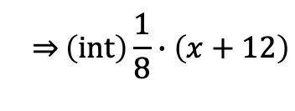
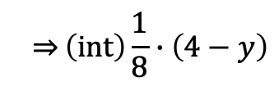
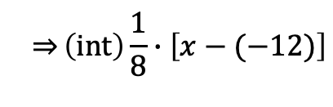

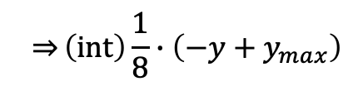

View
(0,0)
(0,0)
$$+x$$
$$+x$$
0,0 | 1,0 | 2,0 | 3,0
0,1 | 1,1 | 2,1 | 3,1
0,2 | 1,2 | 2,2 | 3,2
0,3 | 1,3 | 2,3 | 3,3
Scale
(3, 2)
Truncate
(24, 8)
$$+y$$
$$+y$$
$$translate\left(x\right)=\left(int\right) scale∙\left(x−x_{min}\right)$$
$$translate\left(y\right)=\left(int\right) scale∙\left(−1\right)\left({y−y}_{max}\right)$$
$$\overset{⇒}{}\left(int\right)\frac{1}{8}∙\left[x−(−12)\right]$$
$$\overset{⇒}{}\left(int\right)\frac{1}{8}∙\left({−y+y}_{max}\right)$$
$$\overset{⇒}{}\left(int\right)\frac{1}{8}∙\left(x+12\right)$$
$$\overset{⇒}{}\left(int\right)\frac{1}{8}∙\left(4−y\right)$$

Slide 6
Controller

